Slide 1
An R-matrix approach to the single photon ionization of atoms and ions
Part 1 of photoionisation tutorial
Connor Ballance (Queen's University of Belfast )
Collaborators : C Ramsbottom, F Delahaye and N Badnell
Queen's University /Strathclyde University/ Observatiore de Paris
Atomic Processes in Plasmas (May 16th 2023)
Funded in part by UK STFC, ERC Synergy grants to Queen's University of Belfast

Slide 2
Overview
Introduction of basic photoionization/R-matrix terminology
Photoionization of neutral hydrogen using a configuration
average approach
Tutorial : Photoionization of He-like Fe (hv + 1s2s)
codes + input decks : web address
(hopefully we get this far !!)
Discussion of the resonance features inherent within R-matrix
Some application : comparison with experiment
: opacity calculations (Dr Fontes : next part)

Slide 3
Terminology
Terms : LS coupling representation of the target defined
by spin multiplicity, angular momentum and
parity (Russell-Saunders notation)
Levels : Target states are described in J Pi notation
R-matrix / RMPS (see next slide) : non-perturbative
DW ,plane-wave Born, Configuration average : perturbative
Lotz Formula , Gaunt Factors : semi-empirical
Partial Wave : Target terms/levels couple the angular
momentum of a continuum electron to
give an overall N+1 system with
specific angular momentum.
Scattering approaches fall into two general approaches
Perturbative : Plane-Wave Born, Distorted-Wave
Non-perturbative : CCC (Convergent Close coupling),
R-matrix, TDCC (Time Dependent Close
Coupling)

Slide 4
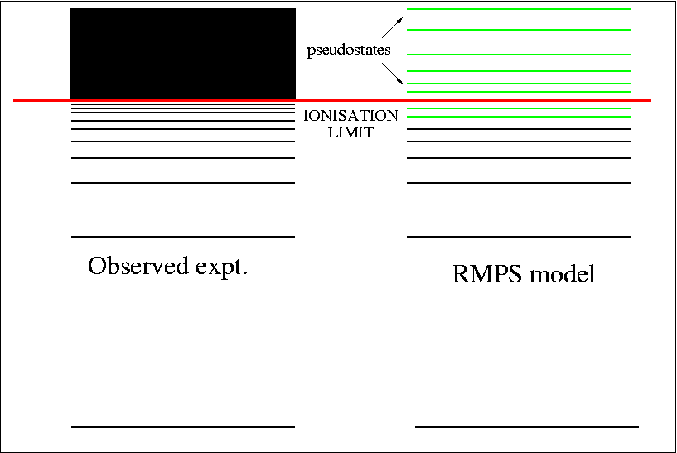
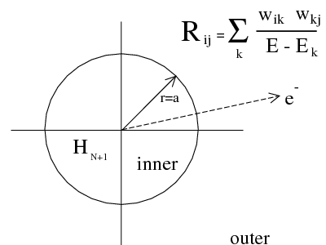
R-matrix/RMPS in a nutshell

Slide 5
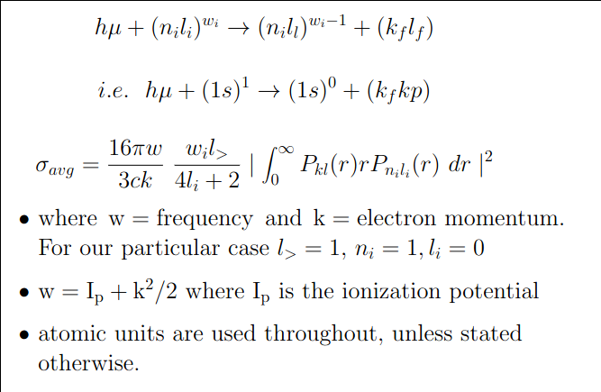
Configuration-Average: hv + H(1s) photoionization (because a single active electron is easier to consider)
CA approx
Compare with Yuri’s
Tutorial.

Slide 6
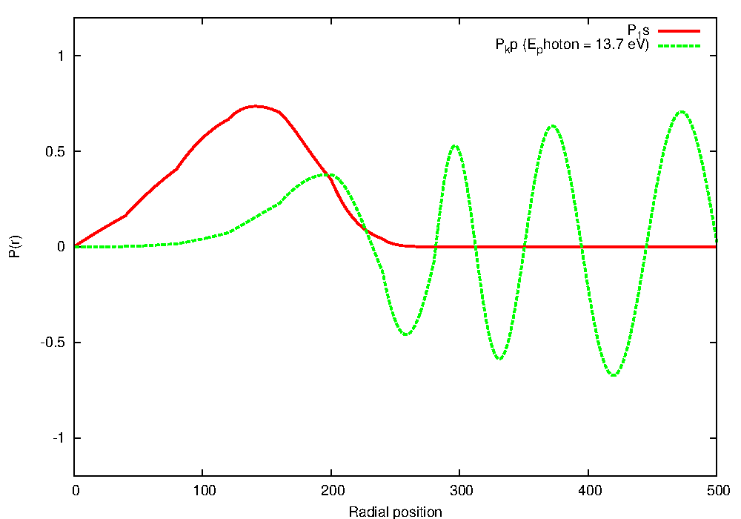
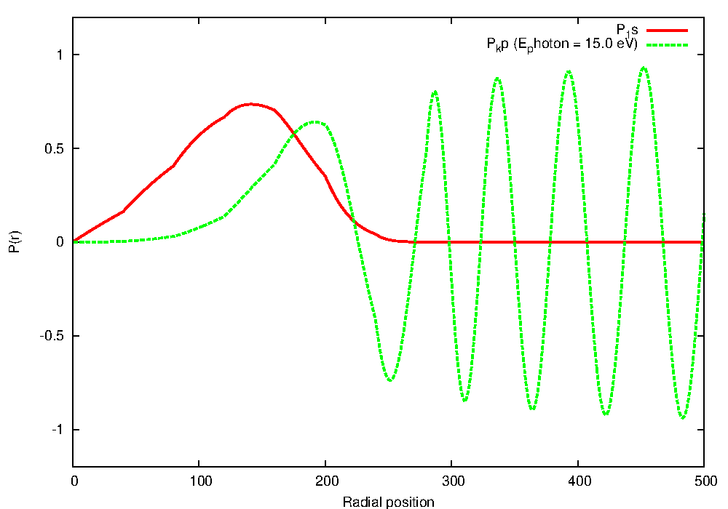
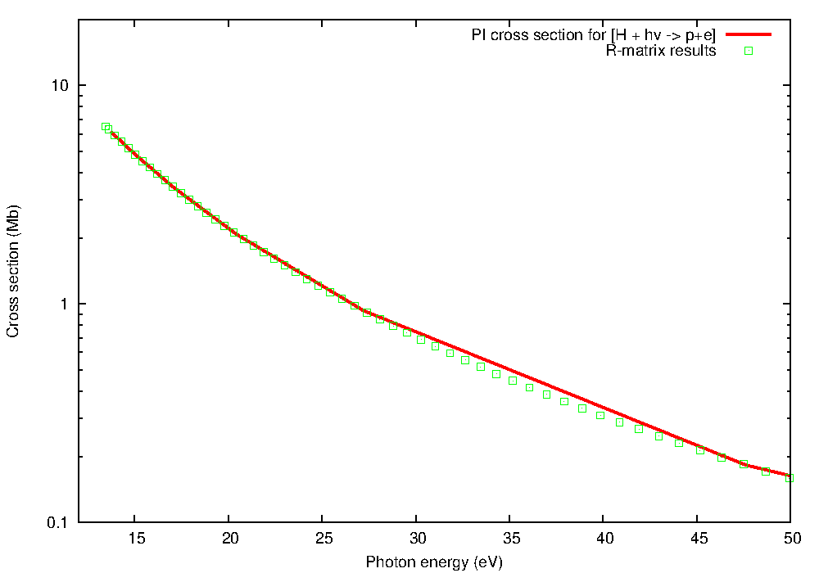
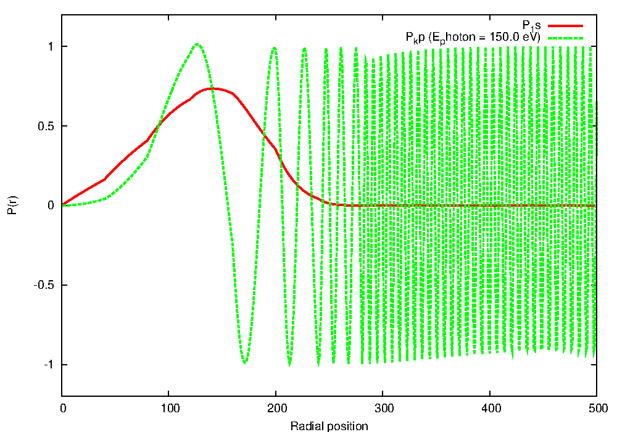
Here the 1s (red) orbital has been multiplied
by r. The 3 graphs from top to bottom
correspond to an incoming photon of 13.6,
15.0 and 150.0 eV (green) .
The wavefunction of representing the
continuum (green) is distorted or perturbed
close to the nucleus (radial position=0)
Each of plots to the left contributes a
single energy point to a total photoionization
plot (see below)
As the photoionisation is a mediated overlap
between an initial discrete bound state and a
continuum (free) wavefunction it is called a
bound-free transition.

Slide 7
R-matrix Tutorial : photoionisation of He-like (1s2s) Fe state
Where can I get the codes used in this tutorial ?
* Codes and this particular example are available at:
http://connorb.freeshell.org/gasp/vienna2023/ (no password required)
* There are 3 downloads: Atomic structure, Rmatrix_inner, Rmatrix_outer
Create 3 separate directories , ‘tar -xvof *.tar’ in each
* ‘go_compile’ (perhaps after chmod u+x) & ‘go_run’ are scripts
compile and run the codes in each section
* Works with gfortran + openmpi (therefore free). Costs only your time
and a little of your sanity. This problem will run in under 2 mins
on an old laptop.
* You can run these at your own leisure, I will be showing only the
results from this test case, we only have a 25 min time slot.
(show usage)

Slide 8
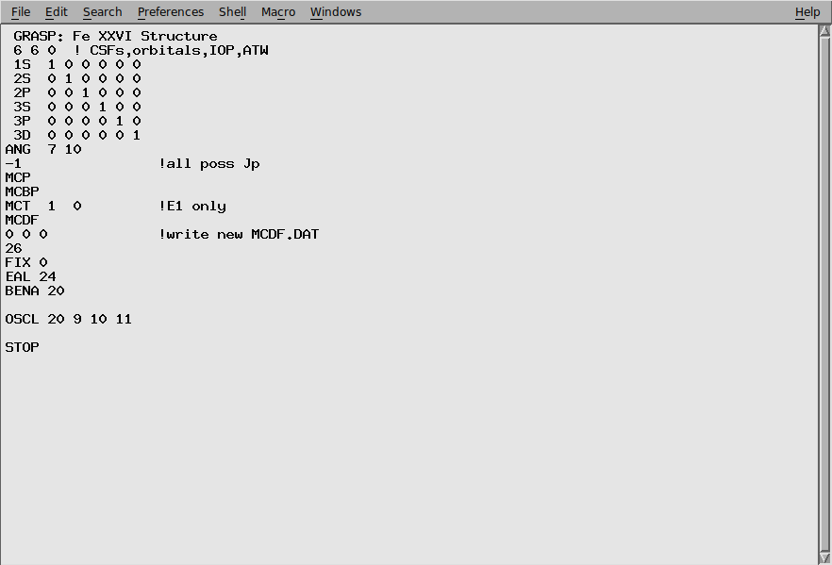
R-matrix Tutorial : photoionisation of He-like (1s2s) Fe state
How do I compile and run the codes ?
Step 1: Run the atomic structure to optimise the orbitals for the structure
Of the residual ion (i.e. in this case He +)
./go_compile, ./go_run
6 non-relativistic
configurations 1s-3d
that will be converted
To relativistic orbitals
within GRASP0
Solves the Coulomb-Dirac
Hamiltonian by default.
Orbitals → TARGET.INP

Slide 9
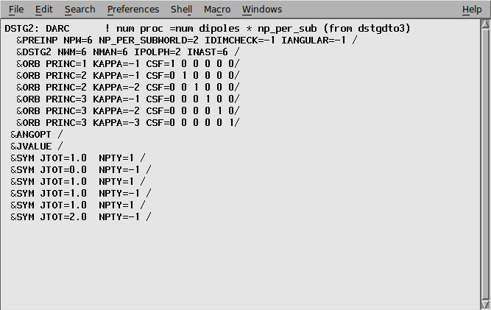
R-matrix Tutorial : photoionisation of He-like (1s2s) Fe state
Step 2: Run the R-matrix inner region, need a continuum basis, build an
N and (N+1) eelectron Hamiltonian or partial wave. Diagonalize the N+1
Hamiltonian to calculate the R-matrix on the inner region boundary.
./go_compile, ./go_run
Looks remarkably similar
to the structure input
except for the listing
of dipole paired partial
waves
Calculates : J=1e-0o
1e-1o
1e-2p
Dipoles
(actually concurrently
as this a parallel code)

Slide 10
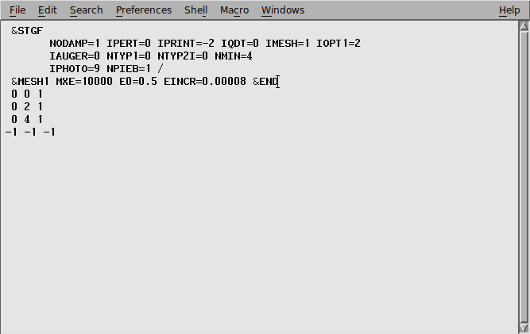
R-matrix Tutorial : photoionisation of He-like (1s2s) Fe state
Step 3: Run the R-matrix outer region region, find an initial discrete boundstate
(stgb) and run a fine mesh for the photoionisation cross section
(needs H.DAT and DXX files from inner region)
./go_compile, ./go_run

Slide 11
If we go back to our trial wavefunction ….
We know that our initial bound state (1s2s Triplet S (J=1) even) , by dipole
selection rules will have 3 possible free partial waves namely, J=0 odd, 1 odd
and 2 odd.
In a simplified interpretation of the above equation
Our initial state (1s2s) Triplet S (J=1) = 1s+ks, 2s+ks, …, 3d+kd (first summation)
+ 1s2s,1s3s, …, 2s3s, 2p3p (second sum)
(not all listed)
The eigenvalues of the second summation span from below the ground-state of
the hydrogen like to energies above. In the former case they form the initial
bound-state and in the later they may form the low members of Rydberg
series seen in the photoionisation cross section.

Slide 12
Very brief review of input
* GRASP (General Relativistic Atomic Structure Package) – code aimed at the
100,000 level calculation that you run on your laptop
6 orbitals → 9 J Pi levels included in photoionisation calculation
R-matrix focuses on the structure of the residual ion
* stg1d_orb, pstg1d_int, pstg2d_dip, pstg3r,pstgd (R-matrix inner region)
* stgb, stgbf0 (which produces photoionisation cross sections) (R-matrix outer region)
You chose how refined you wish the cross to be by the number of photon energies
(1)GRASP provides orbitals delineated on an exponential radial grid (TARGET.INP)
(2) Rmatrix_inner region provides the H.DAT (produces R-matrix) and D files (DXX)
that contain the bound-free dipole matrix elements
(3) R-matrix_outer_region provides the initial bound states (stgb) and the photoioisation
cross sections (pstgbf0)

Slide 13
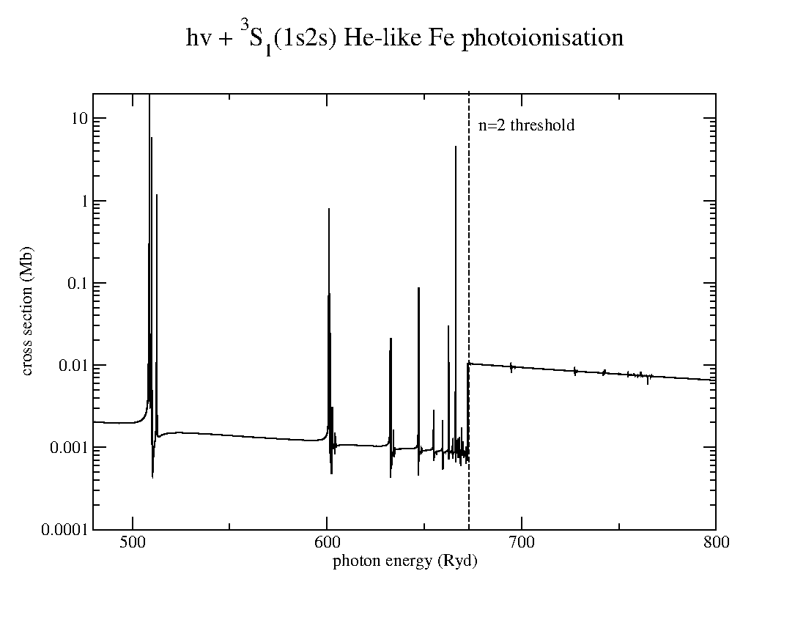
Results

Slide 14
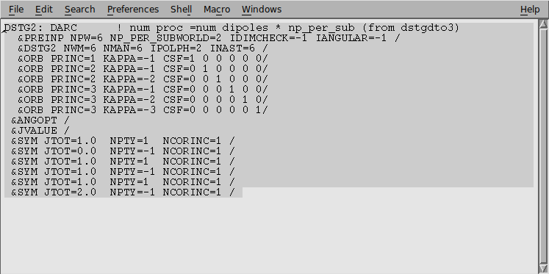
But say we remove the configurations associated with 2s,2p,3s,3p and 3d.
This implies only keep configurations associated with 1s target config.
i.e. remove all 2snl,2pnl,3snl,3pnl ad 3dnl where nl < 3d

Slide 15
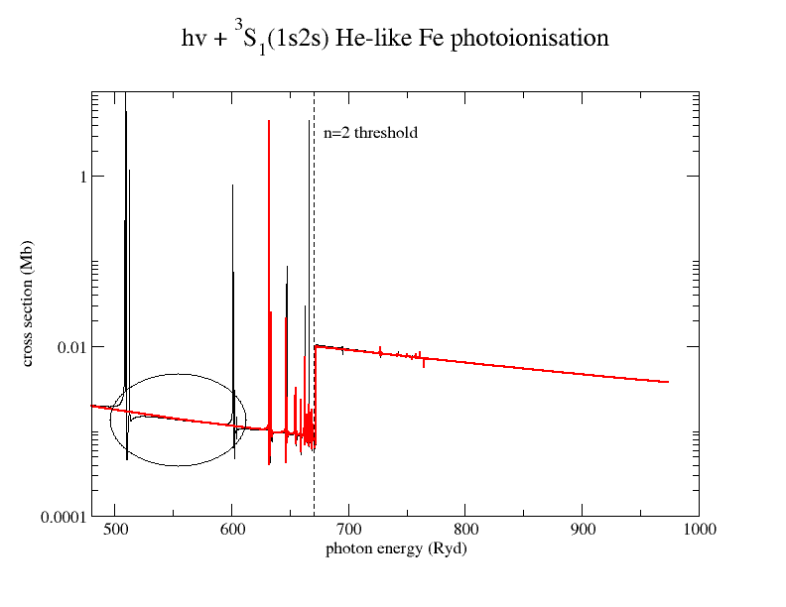
Consequence : removal of first members of Rydberg sequences (ie n=2,3) or ‘in-the-box’ resonances

Slide 16
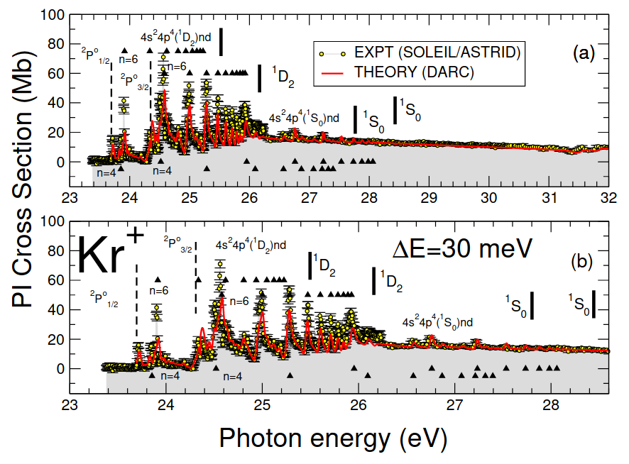
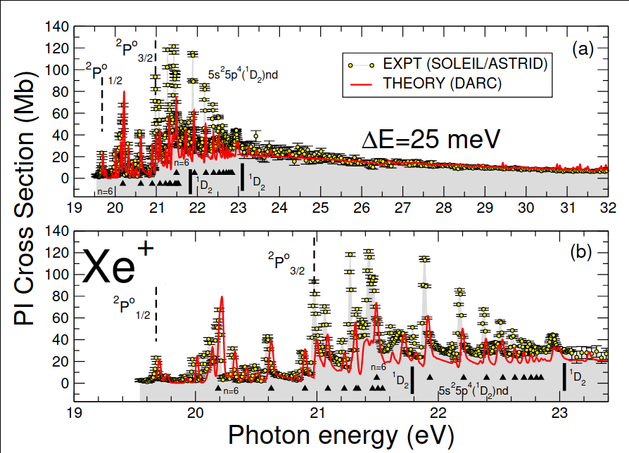
R-matrix largely reproduces the highest resolution experimental measurement
Experimental results from the
SOLEIL experiment as compared
to DARC theoretical values convoluted
width a 25 meV width.
Resonances are all mapped out, even
if the heights do not necessarily agree.

Slide 17
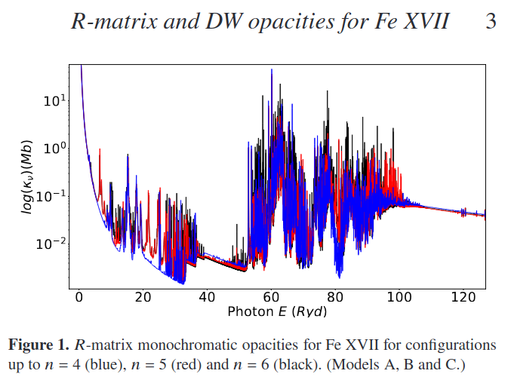
Photoionisation cross sections are one of the ingredients of opacity calculations.Although accurate,not always the most efficient approach
Dr Fontes may talk about this in greater detail.

